Slide 1

Lecture 3 – ISO OSI Model
2.<number>
Copyright © The McGraw-Hill Companies, Inc. Permission required for reproduction or display.

Slide 2
2-1 LAYERED TASKS
We use the concept of layers in our daily life. As an example, let us consider two friends who communicate through postal mail. The process of sending a letter to a friend would be complex if there were no services available from the post office.
Topics discussed in this section:
Sender, Receiver, and Carrier
Hierarchy
2.<number>

Slide 3

Figure 2.1 Tasks involved in sending a letter
2.<number>

Slide 4

Each layer at the sending site uses the services of the layer immediately below it.
The sender at the higher layer uses the services of the middle layer.
The middle layer uses the services of the lower layer.
The lower layer uses the services of the carrier.
2.<number>

Slide 5
2-2 THE OSI MODEL
Established in 1947, the International Standards Organization (ISO) is a multinational body dedicated to worldwide agreement on international standards. An ISO standard that covers all aspects of network communications is the Open Systems Interconnection (OSI) model. It was first introduced in the late 1970s.
Topics discussed in this section:
Layered Architecture
Peer-to-Peer Processes
Encapsulation
2.<number>

Slide 6

Note
ISO is the organization.
OSI is the model.
2.<number>

Slide 7
2-2 THE OSI MODEL
An open system is a set of protocols
  allows any two different systems to communicate regardless of their underlying architecture.
How to facilitate communication between different systems without requiring changes to the logic of the underlying hardware and software?
Flexible, robust, and interoperable model.
Layered framework for the design of network systems that allows communication between all types of computer systems.
2.<number>

Slide 8

Figure 2.2 Seven layers of the OSI model
2.<number>

Slide 9
OSI Layered Architecture
Each layer - family of functions distinct from those of the other layers.
Comprehensive and flexible Architecture.
Allows complete interoperability between incompatible systems.
Within a single machine, each layer calls upon the services of the layer just below it.
Peer-to-peer processes
Each interface defines the information and services a layer must provide for the layer above it.
Well-defined interfaces and layer functions
  provide modularity to a network.
Specific implementation of its functions can be modified or replaced
  without requiring changes to the surrounding layers.
2.<number>

Slide 10

Figure 2.3 The interaction between layers in the OSI model
2.<number>

Slide 11

Figure 2.4 An exchange using the OSI model (ENCAPSULATION)
User Support Layers
Network Support
Layers
2.<number>

Slide 12
2-3 LAYERS IN THE OSI MODEL
In this section we briefly describe the functions of each layer in the OSI model.
Topics discussed in this section:
Physical Layer
Data Link Layer
Network Layer
Transport Layer
Session Layer
Presentation Layer
Application Layer
2.<number>

Slide 13
Note
The physical layer is responsible for movements of
individual bits from one hop (node) to the next.
2.<number>

Slide 14

Figure 2.5 Physical layer
2.<number>

Slide 15
Physical Layer
Coordinates the functions required to
carry a bit stream over a physical medium
Physical characteristics of interfaces and transmission medium.
Representation of bits
    To be transmitted, bits must be encoded into signals- electrical or optical.
  Data rate
    The transmission rate-the number of bits sent each second
Synchronization of bits
  sender and receiver (same bit rate) - clocks
Line configuration
  Connection of devices to the media (Point to Point, Multipoint)
Physical topology
  How devices are connected to make a network
Transmission mode
  Direction of transmission between two devices (Simplex, Half/Full Duplex)
2.<number>

Slide 16
Note
The data link layer is responsible for moving
frames from one hop (node) to the next.
2.<number>

Slide 17

Figure 2.6 Data link layer
Hop to Hop (Node to Node) delivery
2.<number>

Slide 18
Data-Link Layer
Makes physical layer appear error-free to the upper layer
  Reliable Link
Framing
  divides the stream of bits received from the network layer into manageable data units
Physical addressing
  adds a header to the frame to define the sender and/or receiver of the frame
Flow control
  Flow of data must not be allowed to overwhelm receiver ; rate of absorption by RX less than rate at which data produced by TX
Error control
  adds reliability to the physical layer by adding mechanisms to detect and retransmit damaged or lost frames
  Trailer added to the end of the frame
Access control
  Two or more devices are connected to the same link ?
2.<number>

Slide 19

Figure 2.7 Hop-to-hop delivery
2.<number>

Slide 20

Figure 2.8 Network layer
End-to-end delivery
2.<number>

Slide 21
Note
The network layer is responsible for the
delivery of individual packets from
the source host to the destination host.
2.<number>

Slide 22
Network Layer
Source-to-destination delivery of a packet across multiple networks (links).
Logical addressing
Routing
2.<number>

Slide 23

Figure 2.9 Source-to-destination delivery
2.<number>

Slide 24
Note
The transport layer is responsible for the delivery
of a message from one process to another.
2.<number>

Slide 25
Transport Layer
Process-to-process delivery of the entire message
Relationship between packets
Ensures whole message arrives intact and in order
Error control and Flow control at the source-to-destination level
  Entire message arrives at the receiving transport layer without error (damage, loss, or duplication).
  Error correction - retransmission
Service-point Addressing (or Port address)
Segmentation and Reassembly
  Gets the entire message to the correct process on that computer
2.<number>

Slide 26

Figure 2.10 Transport layer
2.<number>

Slide 27

Figure 2.11 Reliable process-to-process delivery of a message
2.<number>

Slide 28
Session Layer
Establishes, maintains, and synchronizes the interaction among communicating systems.
Dialog control
  Allows two systems (processes) to enter into a dialog.
  Allows communication – Half or Full-Duplex
Synchronization
  Allows a process to add checkpoints or synchronization points to data stream
  Acknowledge – retransmission – insert checkpoints
2.<number>

Slide 29

Figure 2.12 Session layer
2.<number>

Slide 30
Note
The session layer is responsible for dialog
control and synchronization.
2.<number>

Slide 31
Presentation Layer
Syntax and Semantics of the information exchanged between two systems.
Translation
  Interoperability between these different encoding methods
  Sender-dependent format –> common format
  Common format -> receiver-dependent format
Encryption
  Ensure privacy
  Encrypt data for security purposes. For ex, password encryption.
  Decryption – reverse process
Compression
  Reduces the number of bits contained in the information
  Transmission of multimedia such as text, audio, and video
2.<number>

Slide 32

Figure 2.13 Presentation layer
2.<number>

Slide 33
Note
The presentation layer is responsible for translation, compression, and encryption.
2.<number>

Slide 34
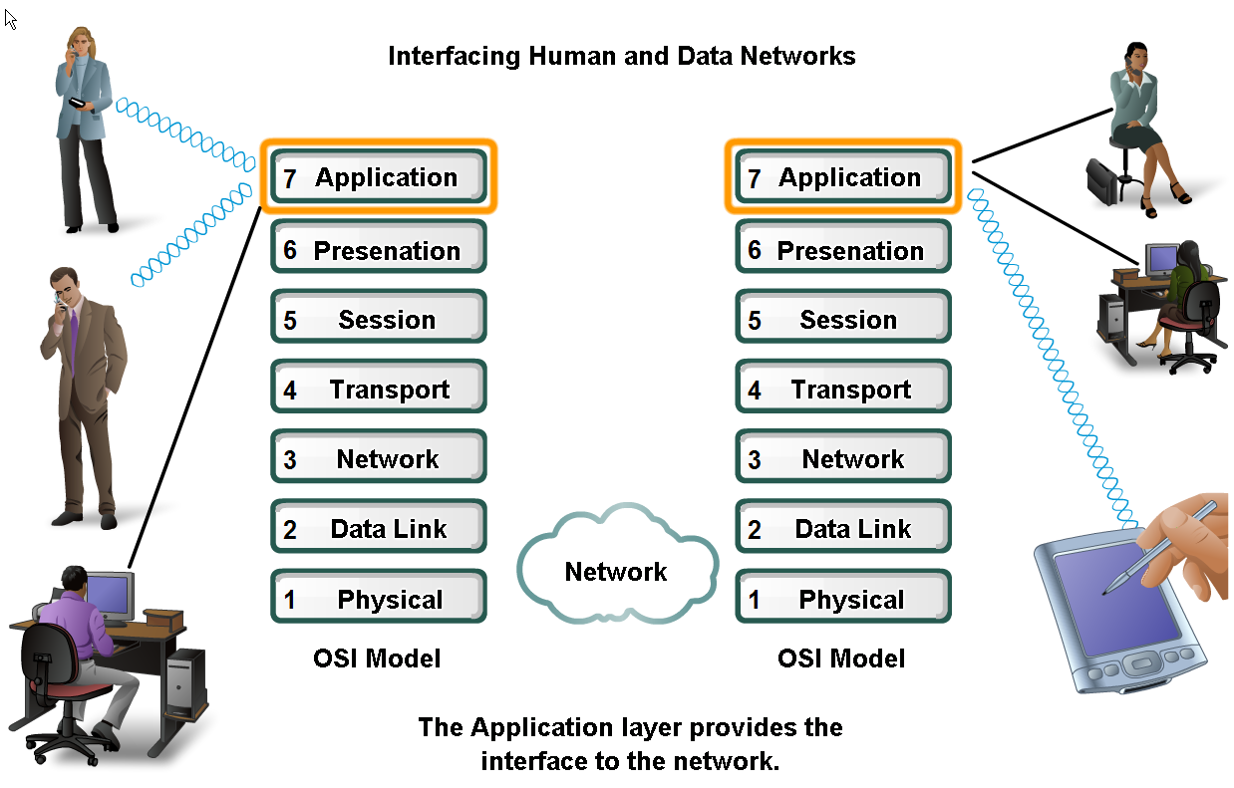
Applications –
The Interface Between Human and Data Networks
Explain that applications provide the means for generating and receiving data that can be transported on the network

Slide 35
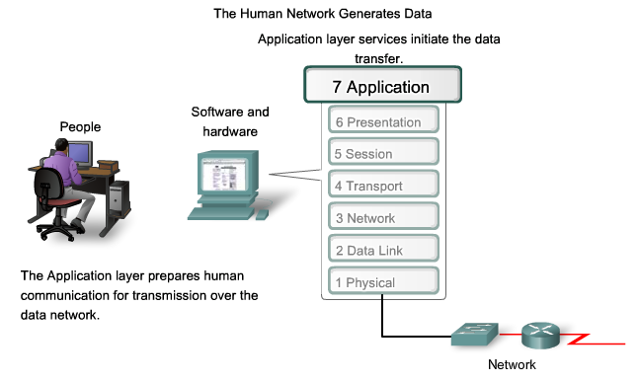
Applications –
The Interface Between Human and Data Networks
Explain the role of applications, services and protocols in converting communication to data that can be transferred across the data network

Slide 36
Note
The application layer is responsible for
providing services to the user.
2.<number>

Slide 37
Application Layer
Enables the user, whether human or software, to access the network.
Provides user interfaces and support for services
  Electronic mail,
  Remote file access and transfer,
  Shared database management,
Network virtual terminal
  Allows a user to log on to a remote host.
  Application creates a software emulation of a terminal
File transfer, access, and management.
Mail & Directory services
2.<number>

Slide 38

Figure 2.15 Summary of layers
2.<number>

Slide 39
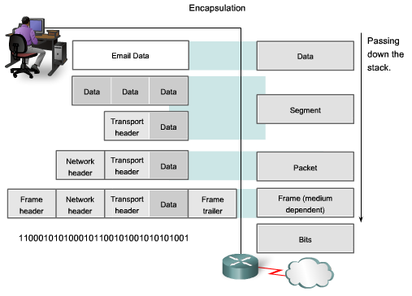
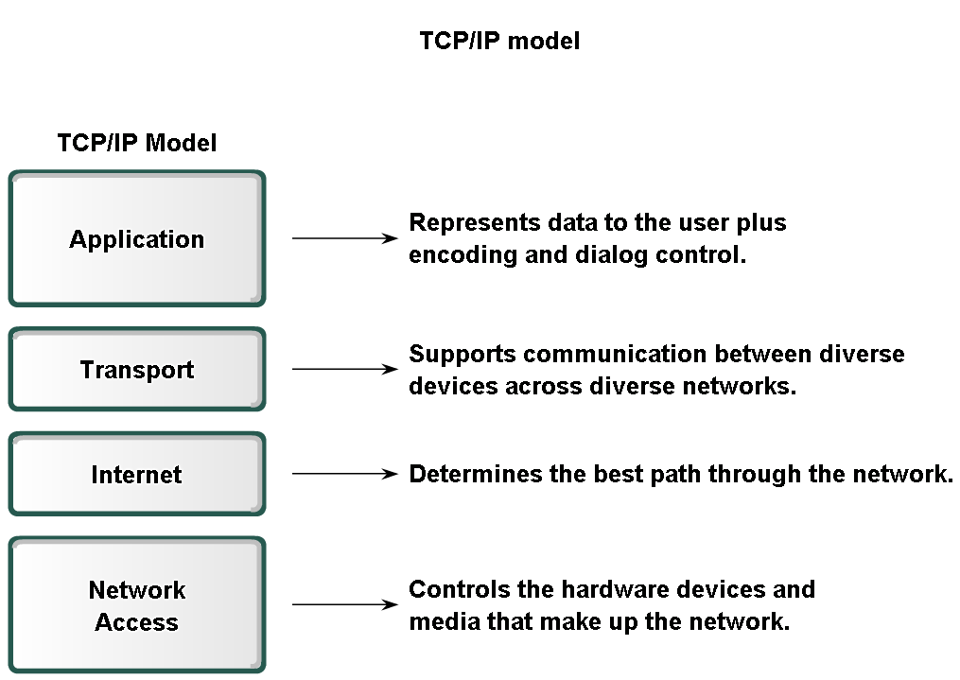
Layers with TCP/IP and OSI Model

Slide 40
2-4 TCP/IP PROTOCOL SUITE
The layers in the TCP/IP protocol suite do not exactly match those in the OSI model. The original TCP/IP protocol suite was defined as having four layers: host-to-network, internet, transport, and application. However, when TCP/IP is compared to OSI, we can say that the TCP/IP protocol suite is made of five layers: physical, data link, network, transport, and application.
Topics discussed in this section:
Physical and Data Link Layers
Network Layer
Transport Layer
Application Layer
2.<number>

Slide 41

Figure 2.16 TCP/IP and OSI model
2.<number>

Slide 42
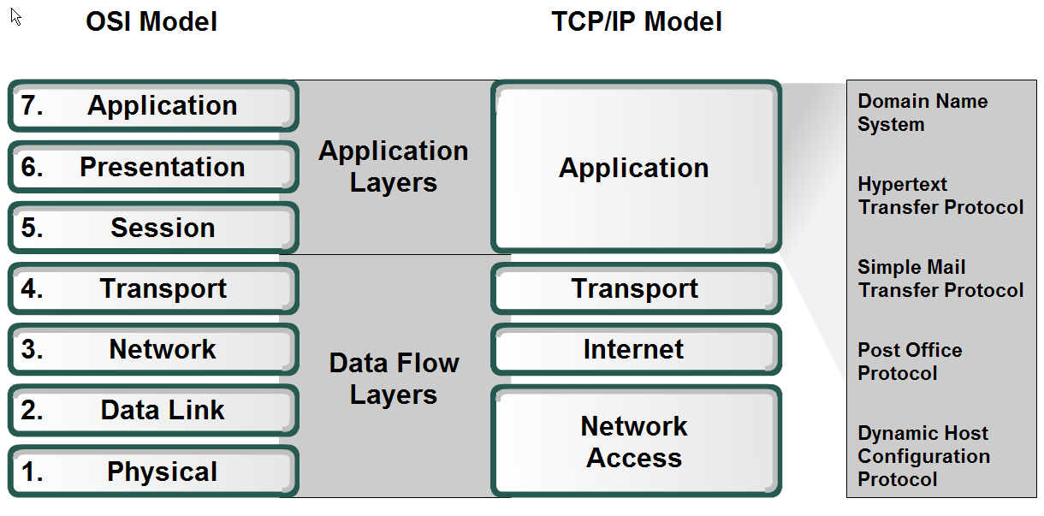
Applications –
The Interface Between Human and Data Networks
Define the separate roles applications, services and protocols play in transporting data through networks

Slide 43
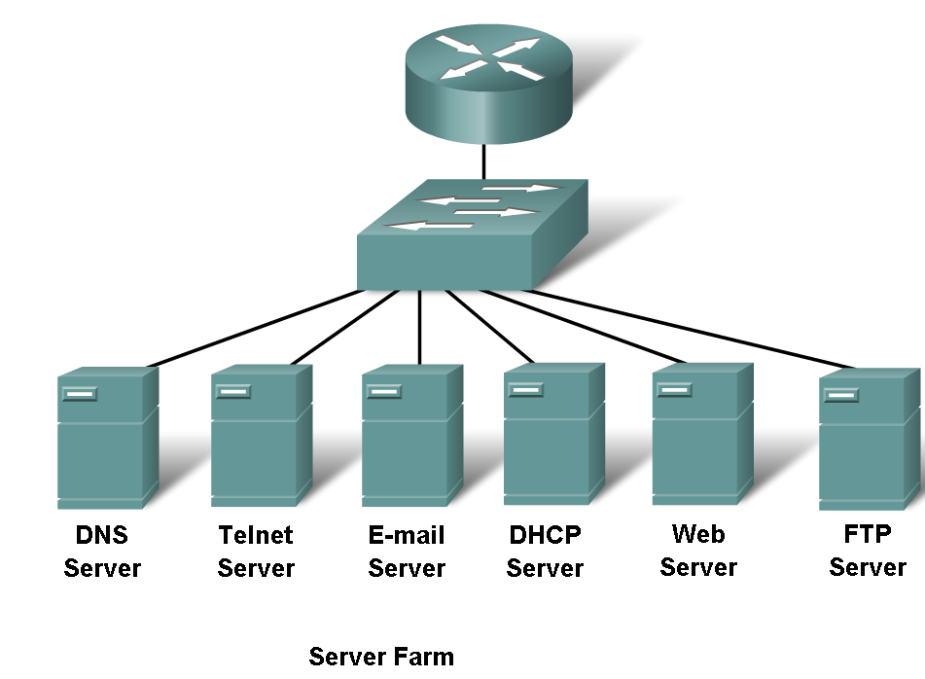
Applications –
The Interface Between Human and Data Networks
Describe the role protocols play in networking and be able to identify several message properties that can be defined by a protocol

Slide 44
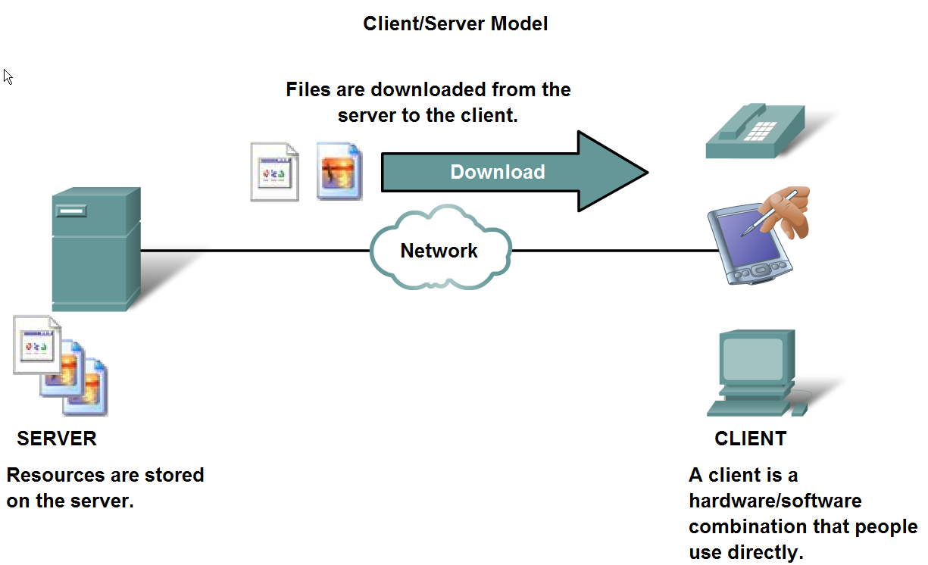
The Role of Protocols in Supporting Communication
Describe the roles of client and server processes in data networks

Slide 45
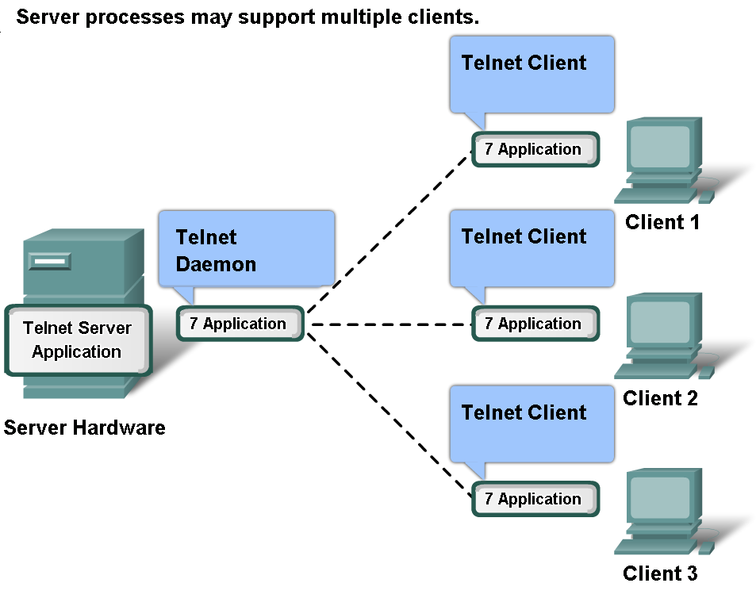
The Role of Protocols in Supporting Communication
List common Application Layers services and protocols

Slide 46
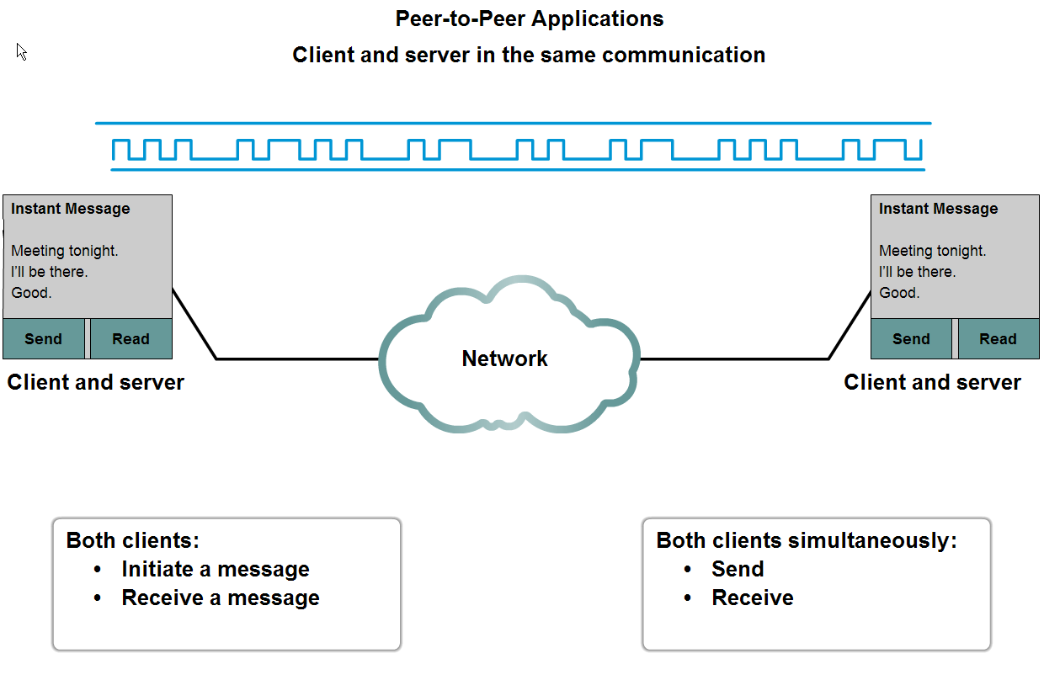
The Role of Protocols in Supporting Communication
Compare and contrast client server networking with peer-to-peer networking and peer-to-peer applications

Slide 47
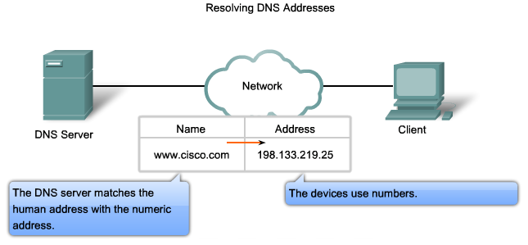
Features, Operation, and Use of Application Layer Services
Describe the features of the DNS protocol and how this protocol supports DNS services

Slide 48
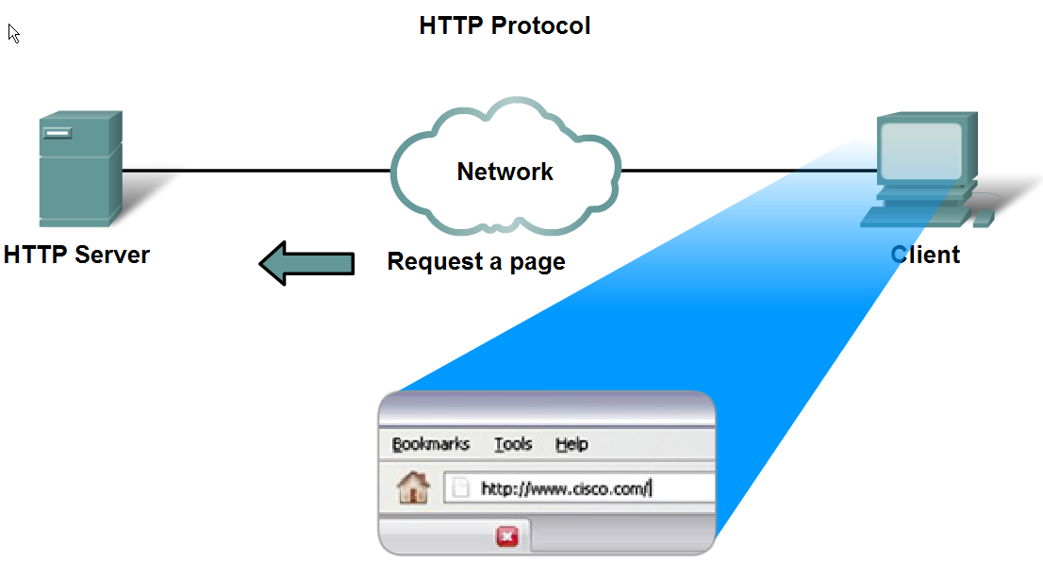
Features, Operation, and Use of Application Layer Services
Describe the features of the HTTP protocol and how this protocol supports the delivery of web pages to the client

Slide 49
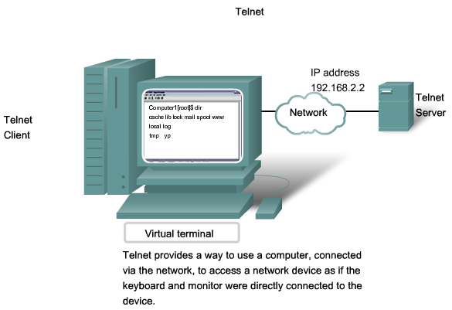
Features, Operation, and Use of Application Layer Services
Describe the features of the Telnet protocol and identify several of its uses in examining and managing networks

Slide 50
Internetworking Protocol (IP)
Unreliable and connectionless protocol.
Best Effort Delivery Service
Transports data in packets – Datagrams
  No Reordering
  No Error Checking
  No tracking of routes
2.<number>

Slide 51
Address Resolution Protocol (ARP)
Associate Logical address with Physical address
To find the physical address of the node when its Internet address is known
Allows host to discover its Internet address when physical address is only known.
Used when computer is connected to network for first time.
Reverse Address Resolution Protocol (RARP)
2.<number>

Slide 52
Internet Control Message Protocol (ICMP)
Network protocol useful in IP network management and administration
Control protocol
Errors in the underlying communications of network applications
Availability of Remote hosts, Network congestion
Overall round-trip time of the probe messages (PING)
Facilitate simultaneous transmission of a message to a group of recipients.
Internet Group Message Protocol (IGMP)
2.<number>

Slide 53
Transport Layer
User Datagram Protocol (UDP) vs Transmission Control Protocol (TCP)
Process-to-process protocol
TCP
  Reliable stream transport protocol (connection-oriented)
UDP
  Connection less protocol
  Packet delay is more serious than packet loss.
Stream Control Transmission Protocol (SCTP)
  Voice over the Internet
  Combines the best features of UDP and TCP
2.<number>

Slide 54
2-5 ADDRESSING
Four levels of addresses are used in an internet employing the TCP/IP protocols: physical, logical, port, and specific.
Topics discussed in this section:
Physical Addresses
Logical Addresses
Port Addresses
Specific Addresses
2.<number>

Slide 55

Figure 2.17 Addresses in TCP/IP
2.<number>

Slide 56

Figure 2.18 Relationship of layers and addresses in TCP/IP
2.<number>

Slide 57
Example 2.1
In Figure 2.19 a node with physical address 10 sends a frame to a node with physical address 87. The two nodes are connected by a link (bus topology LAN). As the figure shows, the computer with physical address 10 is the sender, and the computer with physical address 87 is the receiver.
2.<number>

Slide 58

Figure 2.19 Physical addresses
2.<number>

Slide 59
Example 2.2
As we will see in Chapter 13, most local-area networks use a 48-bit (6-byte) physical address written as 12 hexadecimal digits; every byte (2 hexadecimal digits) is separated by a colon, as shown below:
07:01:02:01:2C:4B
A 6-byte (12 hexadecimal digits) physical address.
2.<number>

Slide 60
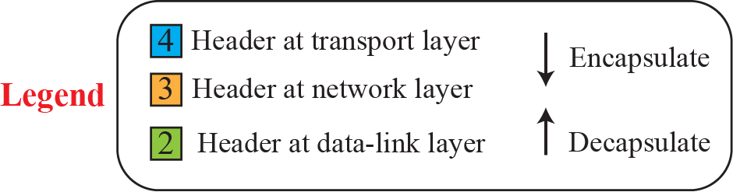
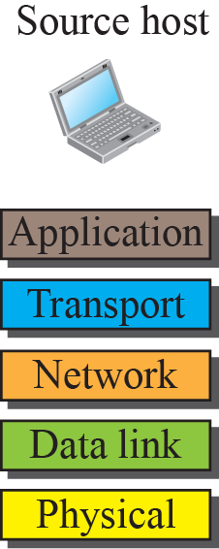
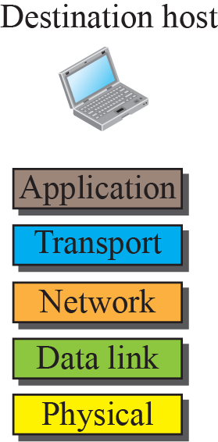

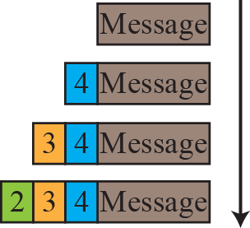
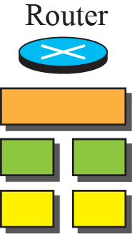
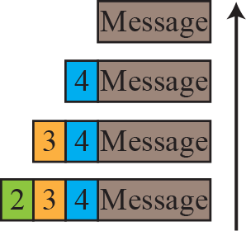
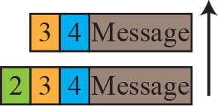
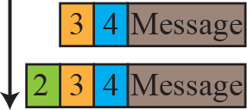
Figure 2.8: Encapsulation / Decapsulation
2.<number>
Notes:
1.#

Slide 61
Example 2.3
Figure 2.20 shows a part of an internet with two routers connecting three LANs. Each device (computer or router) has a pair of addresses (logical and physical) for each connection. In this case, each computer is connected to only one link and therefore has only one pair of addresses. Each router, however, is connected to three networks (only two are shown in the figure). So each router has three pairs of addresses, one for each connection.
2.<number>

Slide 62

Figure 2.20 IP addresses
2.<number>

Slide 63
Example 2.4
Figure 2.21 shows two computers communicating via the Internet. The sending computer is running three processes at this time with port addresses a, b, and c. The receiving computer is running two processes at this time with port addresses j and k. Process a in the sending computer needs to communicate with process j in the receiving computer. Note that although physical addresses change from hop to hop, logical and port addresses remain the same from the source to destination.
2.<number>

Slide 64

Figure 2.21 Port addresses
2.<number>

Slide 65
Note
The physical addresses will change from hop to hop,
but the logical addresses usually remain the same.
2.<number>

Slide 66
A port address is a 16-bit address represented by one decimal number as shown.
753
A 16-bit port address represented
as one single number.
2.<number>

Slide 67
Note
The physical addresses change from hop to hop,
but the logical and port addresses usually remain the same.
2.<number>

Slide 68
Port Number | Description
1 | TCP Port Service Multiplexer (TCPMUX)
5 | Remote Job Entry (RJE)
7 | ECHO
18 | Message Send Protocol (MSP)
20 | FTP -- Data
21 | FTP -- Control
22 | SSH Remote Login Protocol
23 | Telnet
25 | Simple Mail Transfer Protocol (SMTP)
29 | MSG ICP
37 | Time
42 | Host Name Server (Nameserv)
43 | WhoIs
49 | Login Host Protocol (Login)
53 | Domain Name System (DNS)
69 | Trivial File Transfer Protocol (TFTP)
70 | Gopher Services
79 | Finger
80 | HTTP
103 | X.400 Standard
108 | SNA Gateway Access Server
109 | POP2
110 | POP3
115 | Simple File Transfer Protocol (SFTP)
118 | SQL Services
119 | Newsgroup (NNTP)
137 | NetBIOS Name Service
139 | NetBIOS Datagram Service
143 | Interim Mail Access Protocol (IMAP)
150 | NetBIOS Session Service
156 | SQL Server
161 | SNMP
179 | Border Gateway Protocol (BGP)
190 | Gateway Access Control Protocol (GACP)
194 | Internet Relay Chat (IRC)
197 | Directory Location Service (DLS)
389 | Lightweight Directory Access Protocol (LDAP)
396 | Novell Netware over IP
443 | HTTPS
444 | Simple Network Paging Protocol (SNPP)
445 | Microsoft-DS
458 | Apple QuickTime
546 | DHCP Client
547 | DHCP Server
563 | SNEWS
569 | MSN
1080 | Sock
2.<number>

